Slide 1
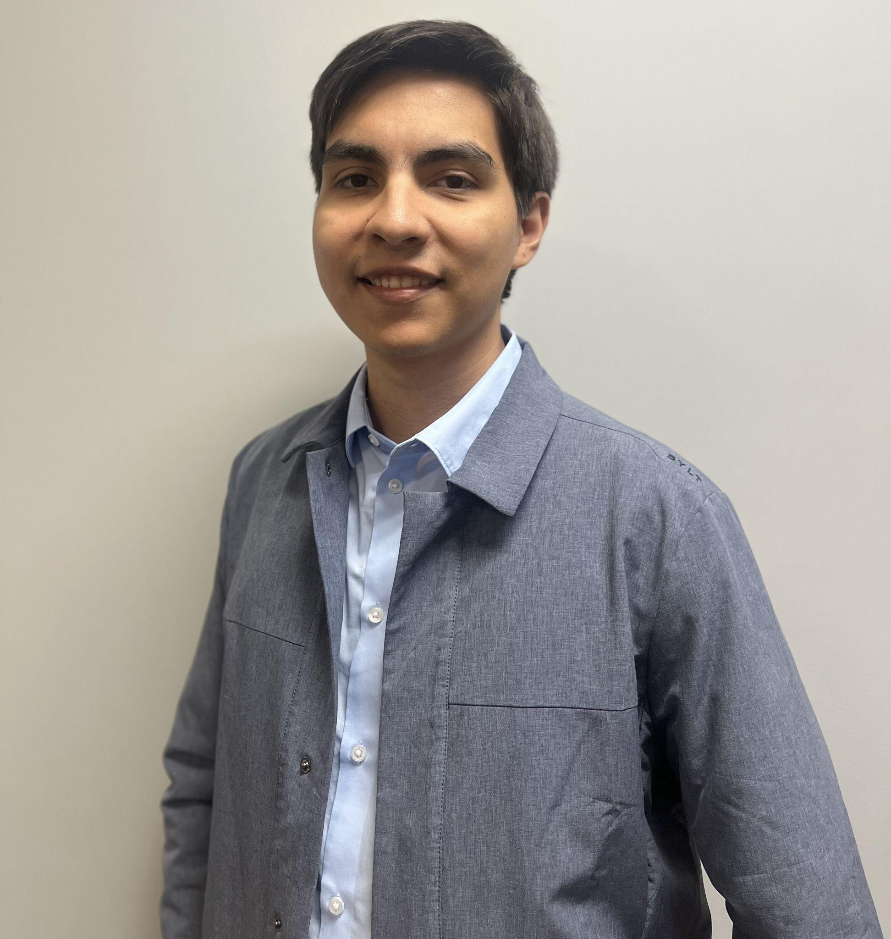

SmartStride
Final Presentation
Group 11 Senior Design Project

Slide 2



The Team Behind the Chair
Matthew Itskovich
CPE
Arturo Lara
CPE
Adam Lily
EE
Even Rees
CPE

Slide 3
Table of contents
Project Motivation
Hardware Visualization
01
04
Goals and Objectives
Hardware Selection
02
05
Specs and Requirements
Electrical Schematics
03
06
The background behind our design philosophy
Diagrams and showcase of our electrical designs
What we intend to accomplish
Components selected and those that were considered
Technical data regarding design specifications
Showcase of electronic components used

Slide 4
Table of contents
PCB Layout
Prototyping & Testing
07
10
Comm Protocol
Administrative Content
08
11
Software Design
09
Implementation of electrical schematics
Data of the effectiveness of the project
Bluetooth Software Stack
BOM and Distribution of Labor
Programs and digital resources used

Slide 5
01
Project Motivation
The background behind our design philosophy

Slide 6
Motivation and Problems
Safety
Easier Movement
Can prevent the injury with object detection, auto-braking, navigation
Make it far easier to for users to move either wirelessly or autonomously
Generic Application
Autonomous Operation
With short-staffed medical settings, non-critical patients can be transported autonomously and safely
Since we are utilizing a wheelchair’s built in control connectivity, we can apply this to other wheelchairs in the future

Slide 7
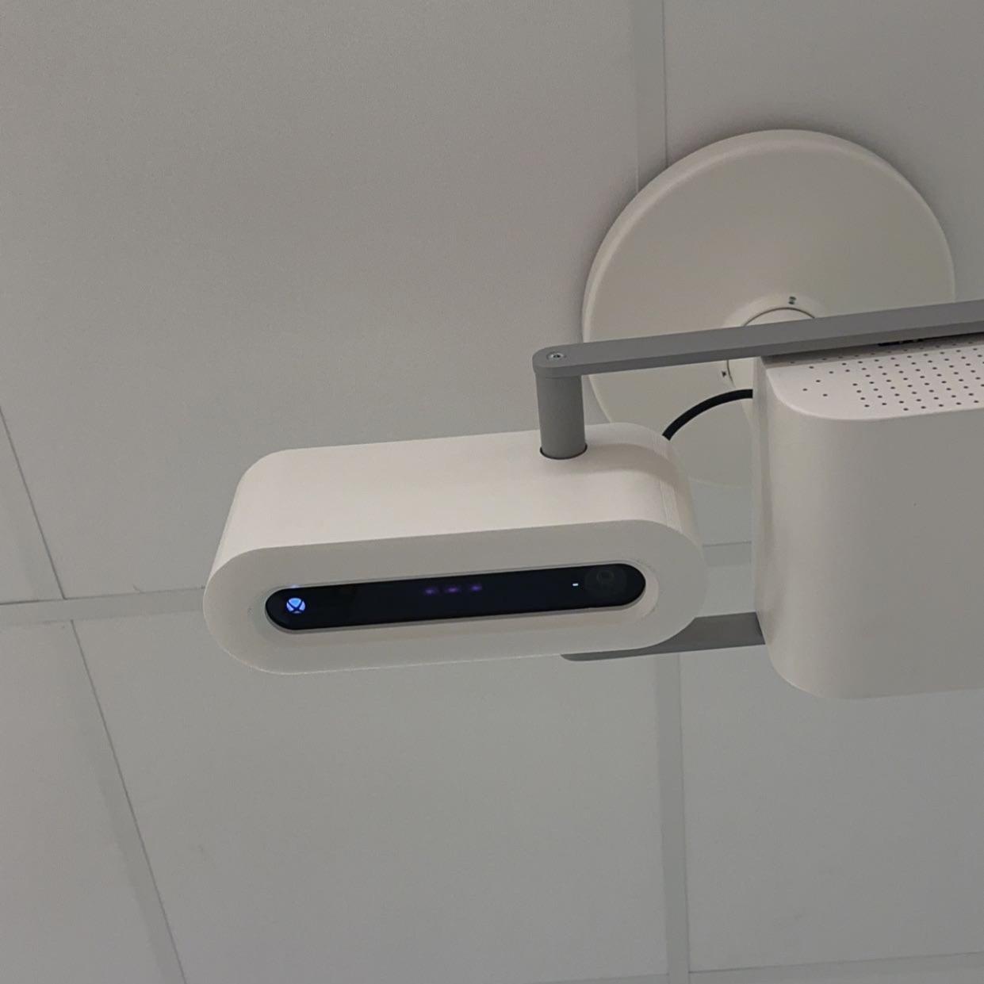
Kinect in the Medical Industry
To go more into our motivation of a generic application to the medical industry is to reuse reliable components that are already in use
The Kinect was the first component that came in to mind for our designs
It is a cheap product capable of using multiple sensors for scanning their environment
Already used by hospitals for medical services such as CT scans for helping align the devices with a person’s topography

Slide 8
02
Goals and Objectives
What we intend to accomplish

Slide 9
Basic Goals and Objectives
Auto Drive
Recognition
Wireless Control
Install a Kinect V2 and other sensors that will collect data and allow for spacial awareness, then move forward
Implement object detection and automatically brake and allow for user manual input
Allow for a user or guardian to wirelessly control the chair and interrupt the driving program

Slide 10
Stretch Goals and Objectives
Self Driving
Object Avoidance
Spatial Mapping
Using mapping and object detection, we can drive the wheelchair to a location in space
Implement object detection and automatically navigate around the object
Allow for the wheelchair to generate a 3D map captured of their location

Slide 11
03
Specs and Requirements
Technical data regarding design specifications

Slide 12
Requirements Specifications
Component | Parameter | Design Specification
Sensor Unit | Range | 1m - 5m
Motors | Load Capacity | 175 lbs - 200 lbs
Main Logic Unit (Pi) | Computational Power | 4 cores, 4 - 8 GB of RAM
Main Logic Unit (Pi) | Response Time in Follow Mode | <1 second- 0.5 seconds
Battery | Power On Time | 3 - 4 Hours Full Load
Wireless Antenna | Reliable Connection | 5 ft - 10 ft range

Slide 13
Sensor Specifications
Component | Operation Spec | Parameter
IR Sensor | 0.5-4.5m operation 70° FOV | Infrared depth detection able to find distance identify object shapes
RGB Camera | 1080p 30fps Camera | Capture images for people and object detection
MPU(Motion Processing Unit) | 3 - Axis Magnetometer 3 - Axis Gyroscope | Ability to track rotational movement

Slide 14
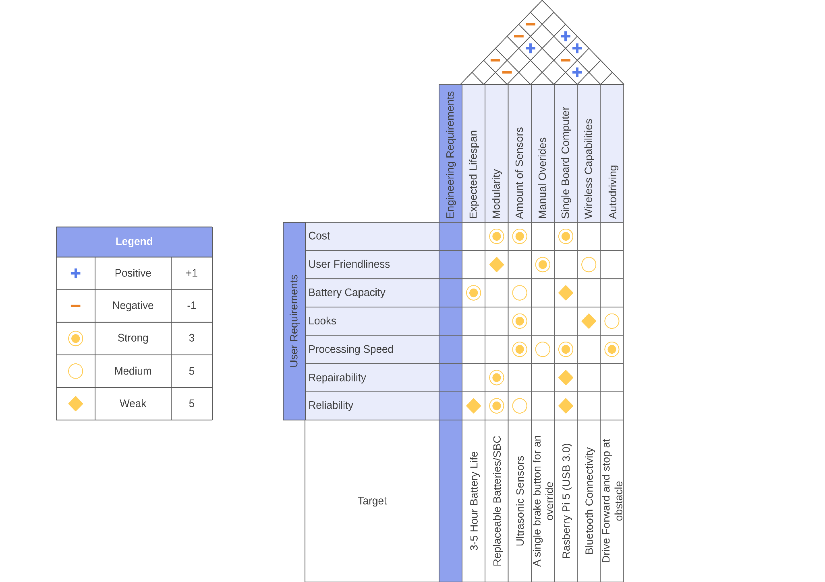
House of Quality

Slide 15
04
Hardware Visualization
Diagrams and showcase of our electrical designs

Slide 16
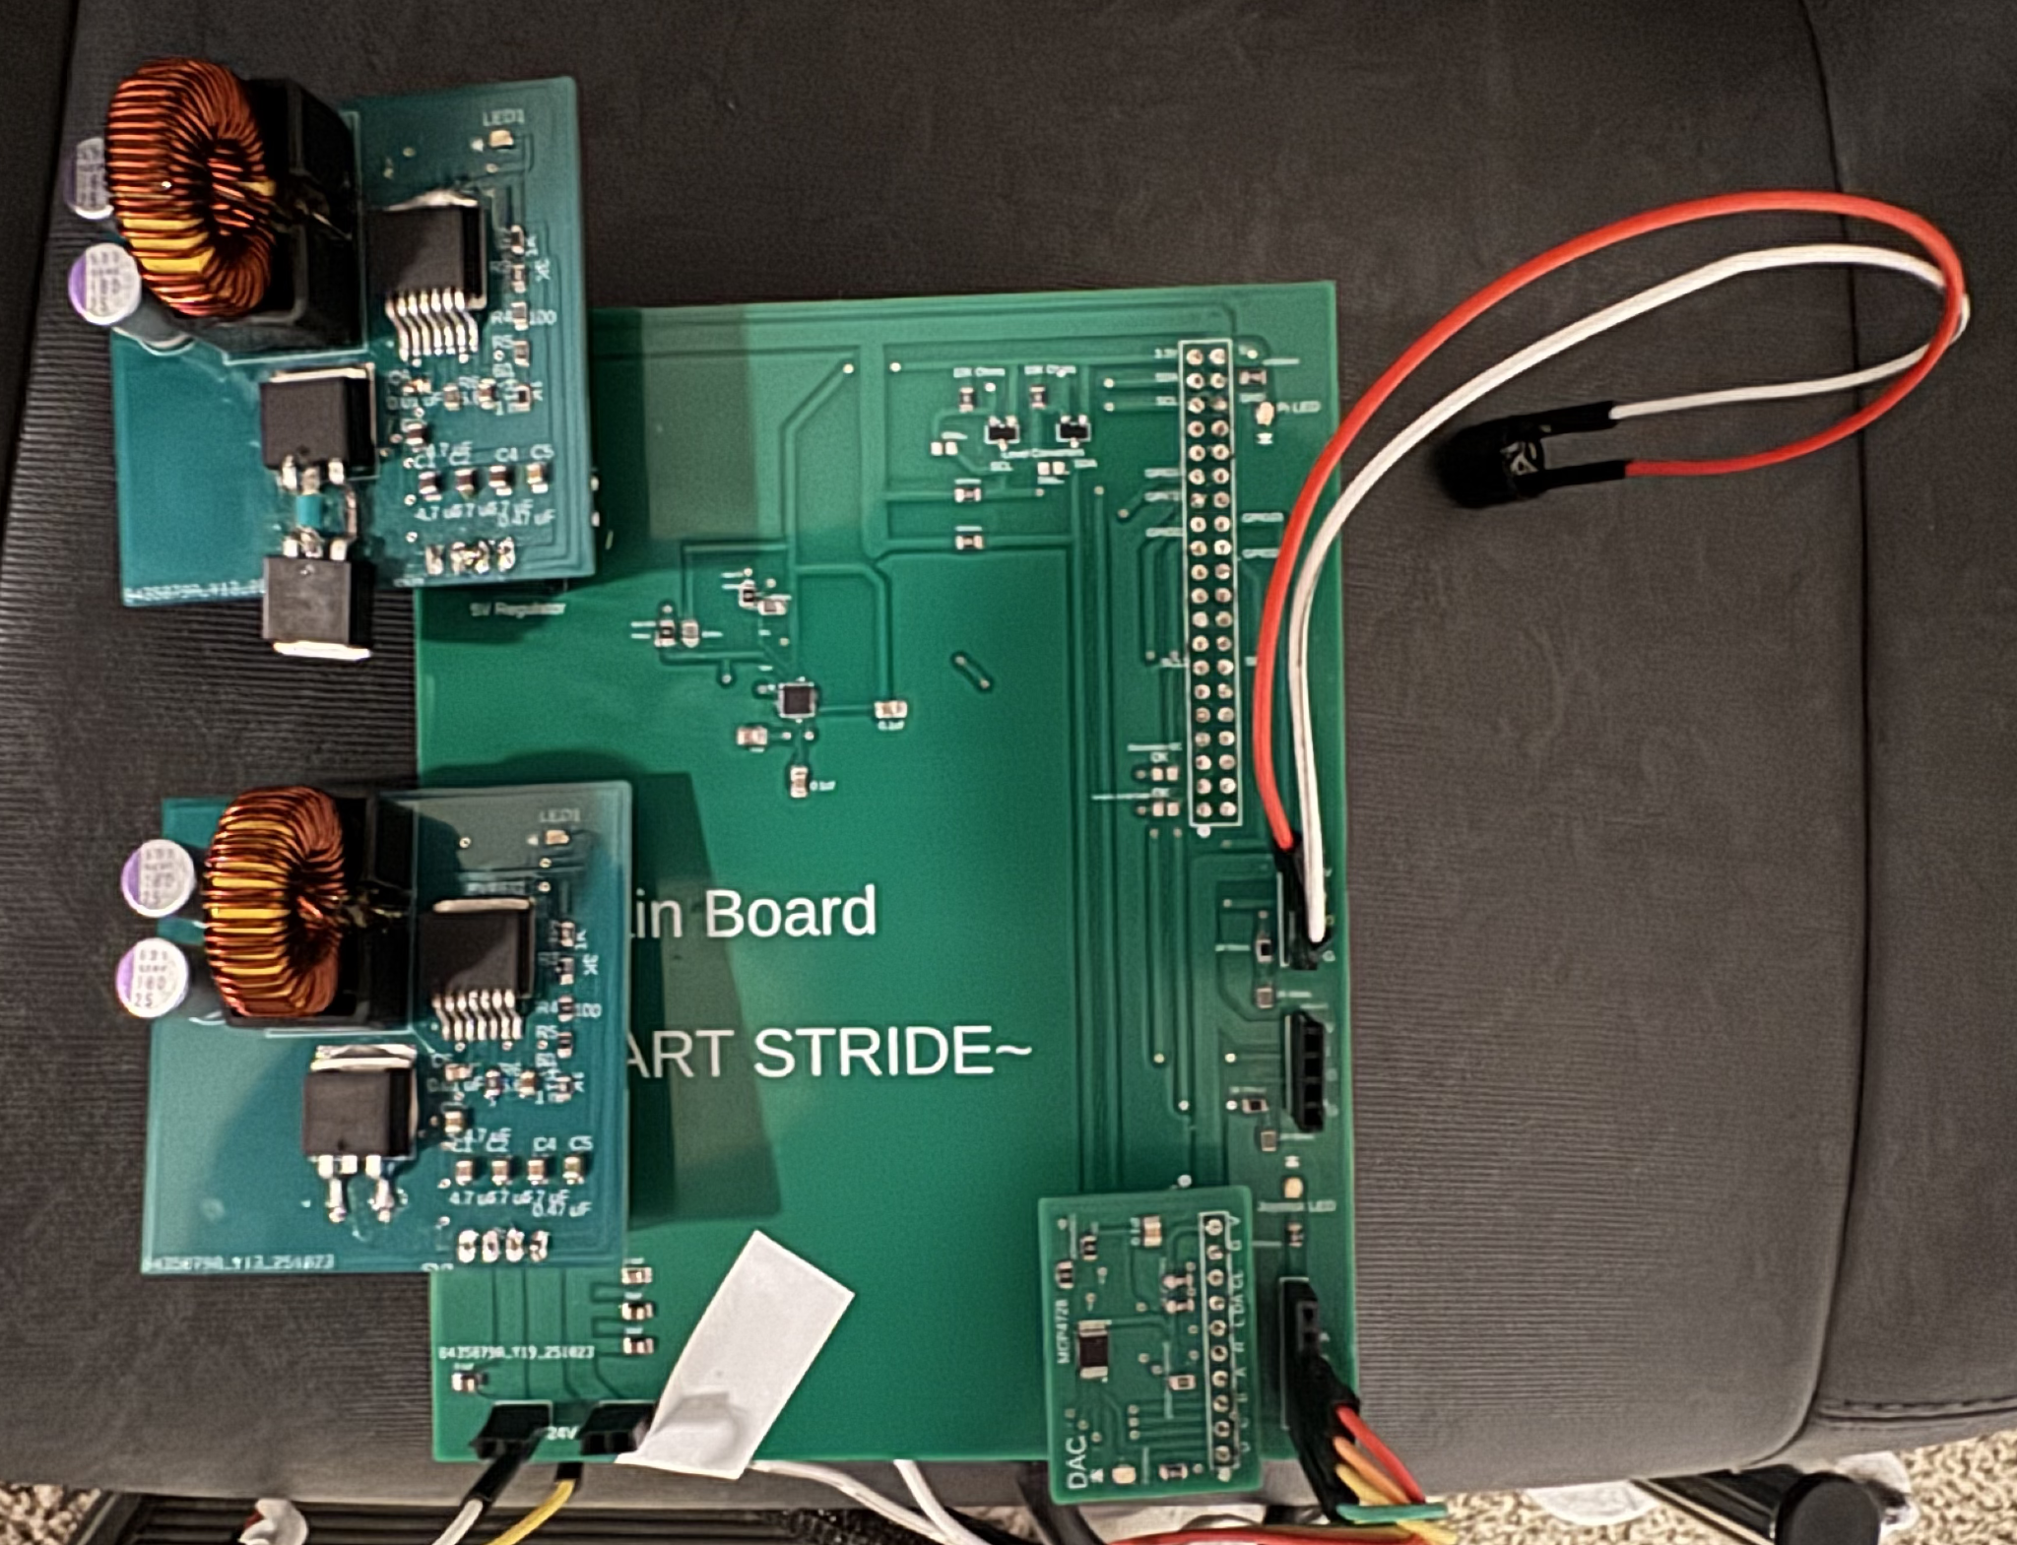
Main Controller Module
5V Regulator
12V Regulator
External Add-On
Pins
DAC
Power Supply
Joystick Output

Slide 17
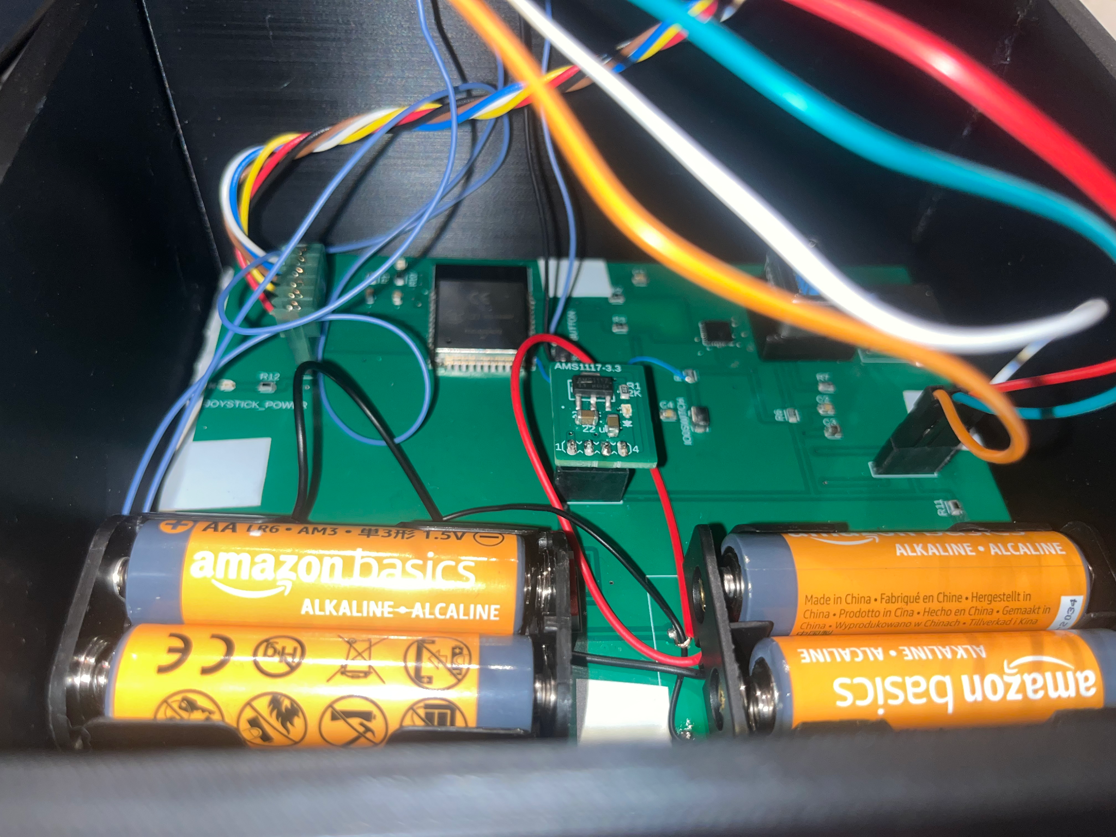
Controller Internals
Joystick
Input
OLED Display Pins
ESP
Power
3.3V Regulator

Slide 18
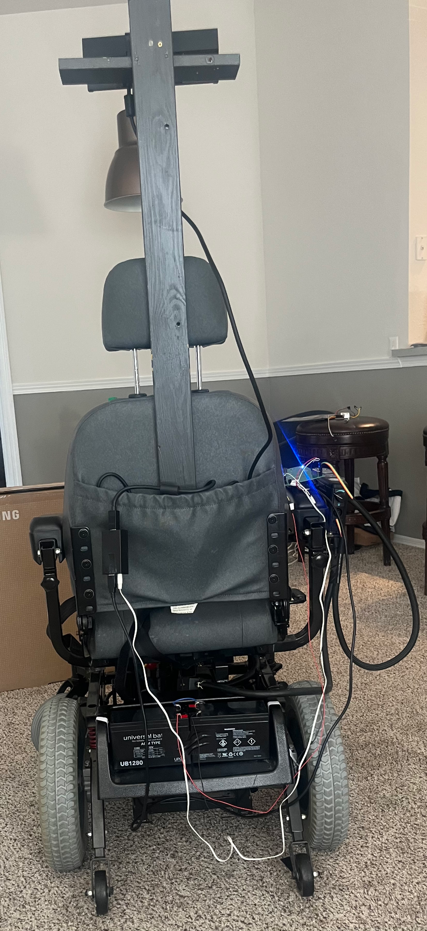
Chair Setup
Kinect
Original chair computer still mounted with motor power supply running through it
Batteries placed behind chair (Kinect and Pi) and below chair (motors and controller)

Slide 19
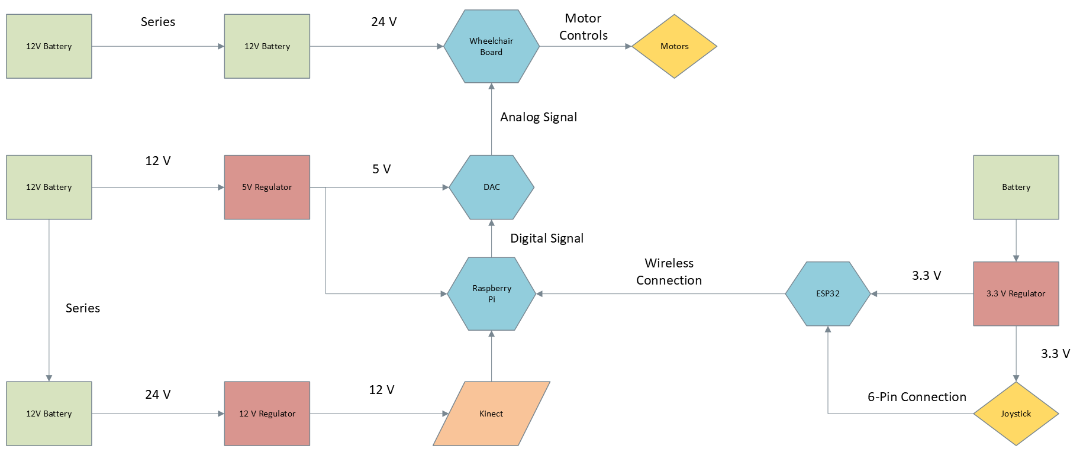
Hardware Block Diagram

Slide 20
05
Hardware Selection
Components selected and those that were considered

Slide 21
Power Distribution
Component | Fed From | Voltage | Amps | Power (Watts)
Raspberry Pi | 5V Regulator | 5V | 3 A | 15 W
Kinect V2 | 12V regulator | 12V | 2.67 A | 32.04 W
LED Display and Joystick | 3.3V Regulator | 3.3V | ≃ 0.2 - 0.3 A | ≃ 0.66 W - 0.99W
12V Reg | Two-12V 10aH batteries in series (24V) | 12 V | 5 A | 60 W
5V Reg | 12 V Reg | 5 V | 5 A | 25 W
3.3 V Reg | 4 AA-Batteries | 3.3 V | 1 A | 3.3 W

Slide 22
Sensor Comparison
Main focus for the sensor is the
Criteria | KinectV2 | Lidar | Ultrasonic
Cost | ~$20 | $80-$150 | $2.50
Range | 0.5m to 4.5m | 0.1 m to 8m | 10cm to 450cm
Resolution | IR 512x424 pixels | 0.8cm | 0.3cm
FOV | 30° | 360° | 70°
Frequency | 60 hz | 6 hz | 100000 hz

Slide 23
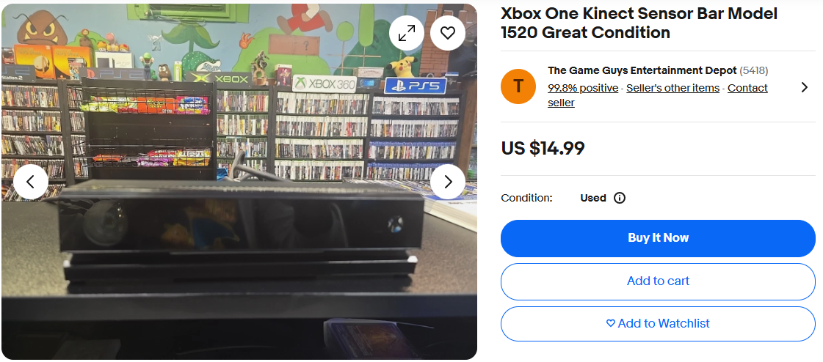
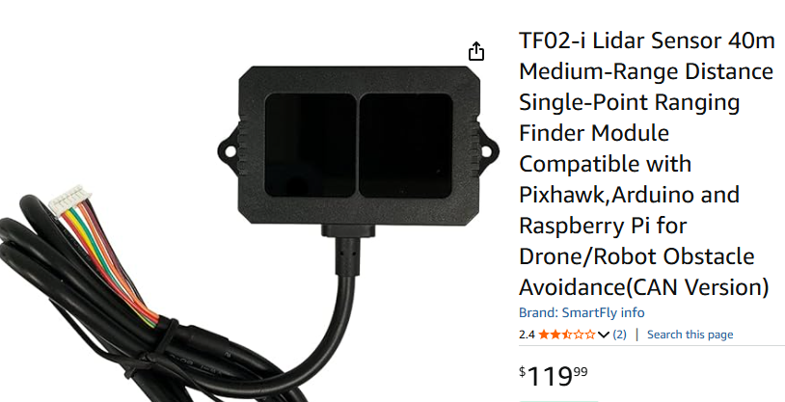
Kinect vs LIDAR Sensors
The KinectV2 is readily available on the secondhand market with a cheap price tag it’s easy to find affordable pre-owned models
The average Lidar sensor goes for around a hundred or more dollars and while it has increased range it does not increase the efficiency of the chair

Slide 24
Main Processing Unit Comparison
Criteria | Dell 9020M | Raspberry Pi 5 | Jetson Nano
Processor (CPU) | Intel Core i7-4785T (4-Core) | 2.4GHz Quad-core ARM Cortex-A76 | 1.43GHz Quad-core ARM A57
Graphics (GPU) | Intel HD Graphics 4600 | VideoCore VII (OpenGL) | 128-core Maxwell (CUDA)
Memory (RAM) | 8GB DDR3 | 8GB LPDDR4X | 4GB LPDDR4
Cost | $0 (Owned) | $90 | Discontinued ($200)
Pros | • No upfront cost • Strong CPU | • Low cost & available • Huge ecosystem | • Strong GPU for its time • 4x USB 3.0 ports
Cons | • Very poor power efficiency • Extremely weak GPU • No GPIO Pins | • Weaker GPU & CPU than Jetson • Nonstandard power input | • Outdated & hard to find • Slower CPU • Lacking Community Support
Main processor needs to be powerful enough to work with Kinect
Raspberry Pi was chosen as latest model met all of our requirements with some overclocking

Slide 25
Wireless Processing Unit
The CPU for the controller needs to have built in Bluetooth with
ESP32 was chosen due to its versatility, speed, and price
Team also has had experience working with it
Criteria | ESP-32S | Raspberry Pi Pico 2 | Arduino Nano RP2040
Processor (CPU) | 32-bit LX6 Dual Core microprocessor 240MHz | Dual Cortex-M33 or Hazard3 processors 150MHz | Raspberry Pi® RP2040 133MHz
Flash Memory | 4mb SPI flash memory | 4mb on board flash memory | 16MB Flash IC
ADC Channels | 16 ADC channels | 3 ADC channels | 8 ADC channels
DAC | two dedicated 8-bit DAC channels. | No dedicated DAC converter can use PWM for rudimentary version | No Dedicated DAC but PWM is possible

Slide 26
Regulator Comparison (5V & 12V)
Buck boost provides the most versatility for our needs.
Buck-Boost provides good ranging input voltage.
Buck Boost offers greater flexibility for future design changes or expansions.
Criteria | Buck | Boost | Buck-Boost
Type | Step Down | Step Up | Step Up-Down
Operating Range | 3V - 20V | 5V - 30V | 3V - 30V
Durability | High | High | Moderate - High
Lifespan | 5 - 10 years | 5 - 10 years | 3 - 7 years
Maintenance | Minimal | Minimal | Minimal-Moderate
Cost | $3 | $4 | $5

Slide 27
Regulator Chosen (5V & 12V)
Buck boost provides the most versatility for our needs.
Buck-Boost provides good ranging input voltage.
Buck Boost offers greater flexibility for future design changes or expansions.
Model | Input Voltage | Output Current | Price | Supplier
LM 7805 | 0V - 35V | 3A | $1.43 | Digikey
LM 2679-ADJ | 8V - 40V | 5A | $5.18 | Digikey
LM 2940 | 6V - 26V | 5mA - 1A | $1.94 | Amazon

Slide 28
Battery Comparison
Sealed Lead acid is the cheapest of all types
Original wheelchair batteries were SLA
SLA is not the most durable but good enough for our use cases and outdoor user operation
Criteria | Sealed Lead Acid | Gel Cell | Lithium Ion
Cost | $100 - $250 | $120 - $300 | $300 - $800
Lifespan | 2 - 4 years | 4 - 6 years | 8 - 15 years
Durability | Least Durable | Intermediate | Most Durable
Operating Temp | -15° - 30° | -20° - 50° | -20° - 60°
Weight | 38.6 lbs | 37 lbs | 10.62 lbs - 15.5 lbs
Safety | Intermediate | Intermediate | Safest

Slide 29
Battery Chosen
Mighty Max was the cheapest available option per battery.
On Amazon for fast shipping
Mighty Max is a Well known manufacturer
Manufacturer | Model | Price | Capacity | Supplier
Mighty Max | ML35-12 | $148.99 (2) | 35 Ah | Amazon
Duracell | SLI22NF | $109.99 | 35 Ah | Batteries Plus
AJC | EB1255ONB | $90.19 | 35 Ah | Battery Clerk

Slide 30
06
Electrical Schematics
Showcase of electronic components used

Slide 31
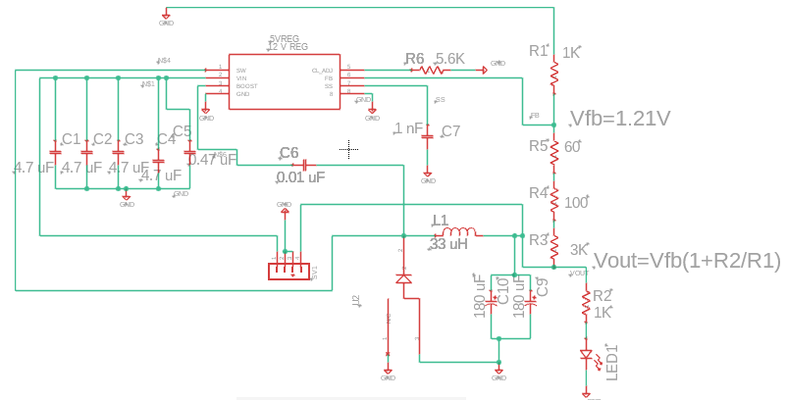
5V / 12V Regulator
LM2679ADJ
8V ≤Vin≤ 40V
Iout is generally 5A
Only difference between the 5V and 12V regulator design is the feedback resistor connected to output header.

Slide 32
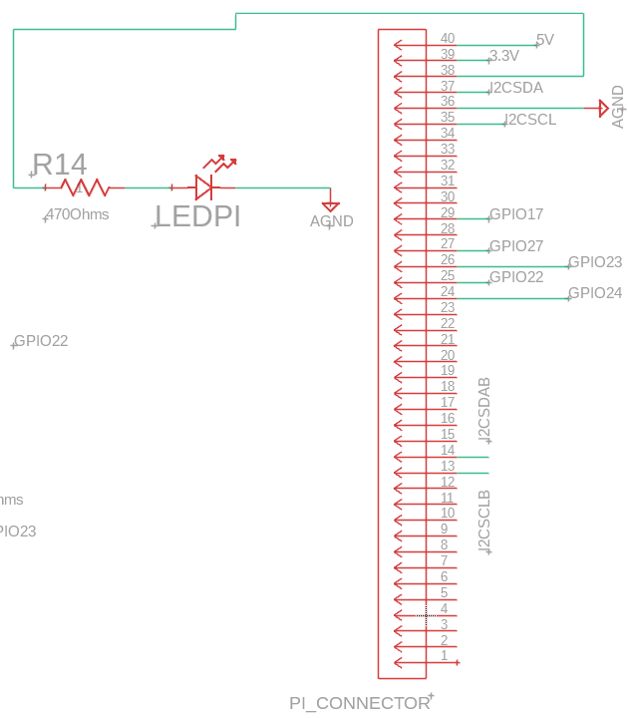
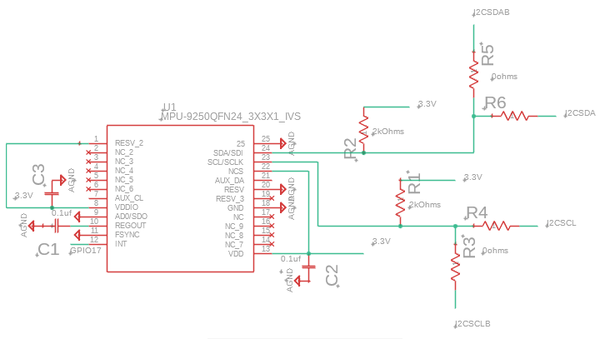
Pi to Wheelchair Board Schematic
MPU, 2 level converters, DAC, and PI,
Regulators: 12V to 3.3V/5V regulators
24V to 12V regulator for Kinect

Slide 33
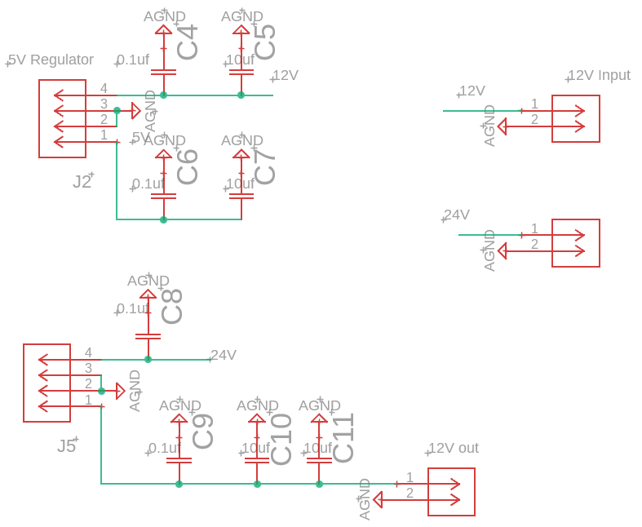
Pi to Wheelchair Board Schematic (Cont.)
12V regulator supplied from two-12V 10aH batteries
5V regulator hooked up to 12V rail fed by 12 V regulator

Slide 34
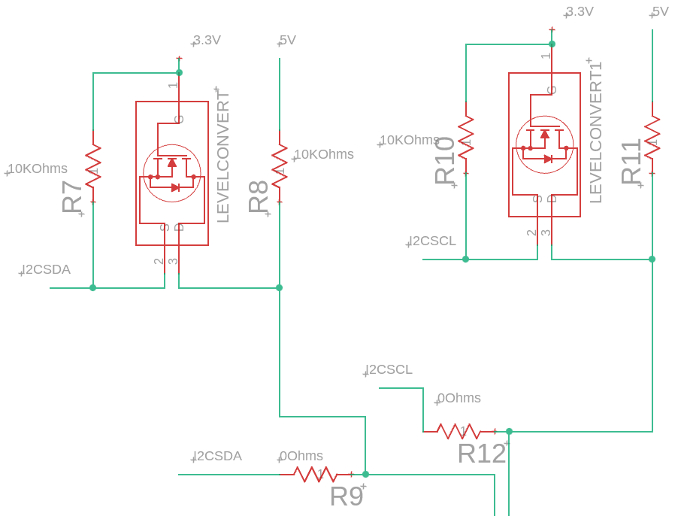
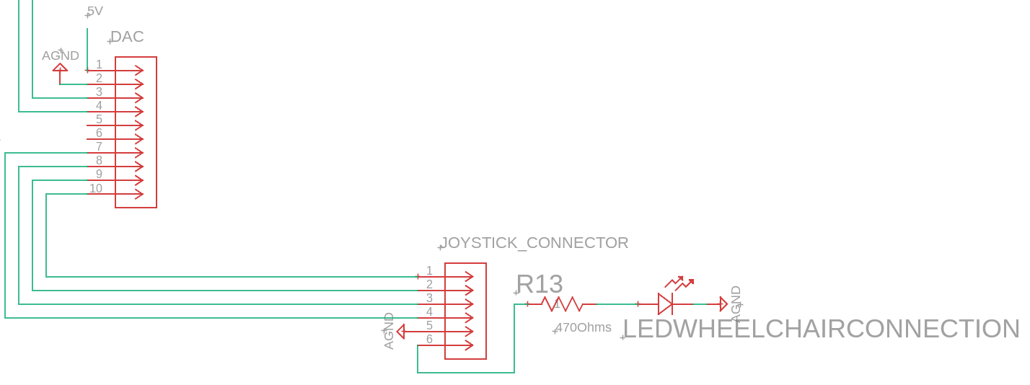
Pi to Wheelchair Board Schematic (Cont.)
Level converters are needed because Pi and Dac operate on different voltage logic. Pi operates at 3.3V and DAC requires 5V.

Slide 35
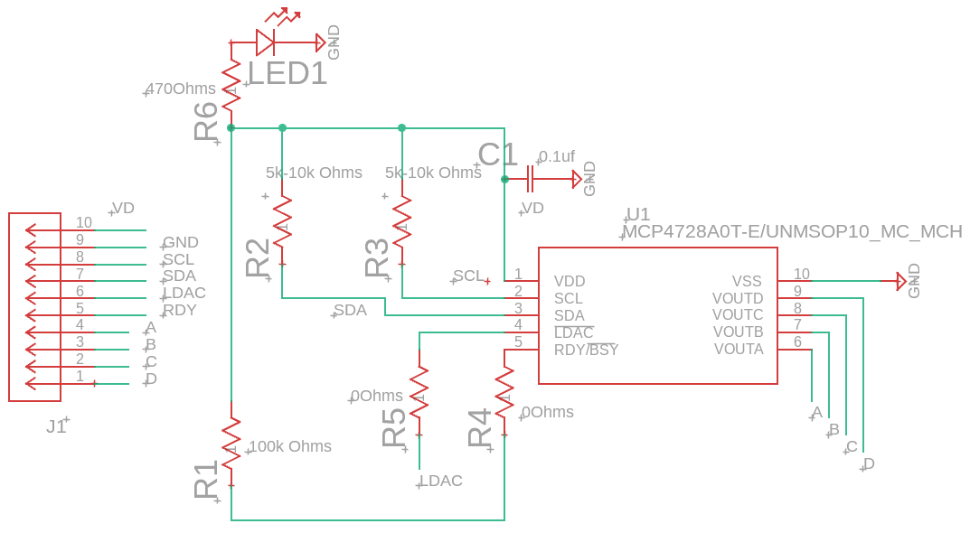
Digital-to-Analog-Converter (DAC)
MCP4728 Chip
12-bit
4-channels
Output Voltage 2.048 V

Slide 36
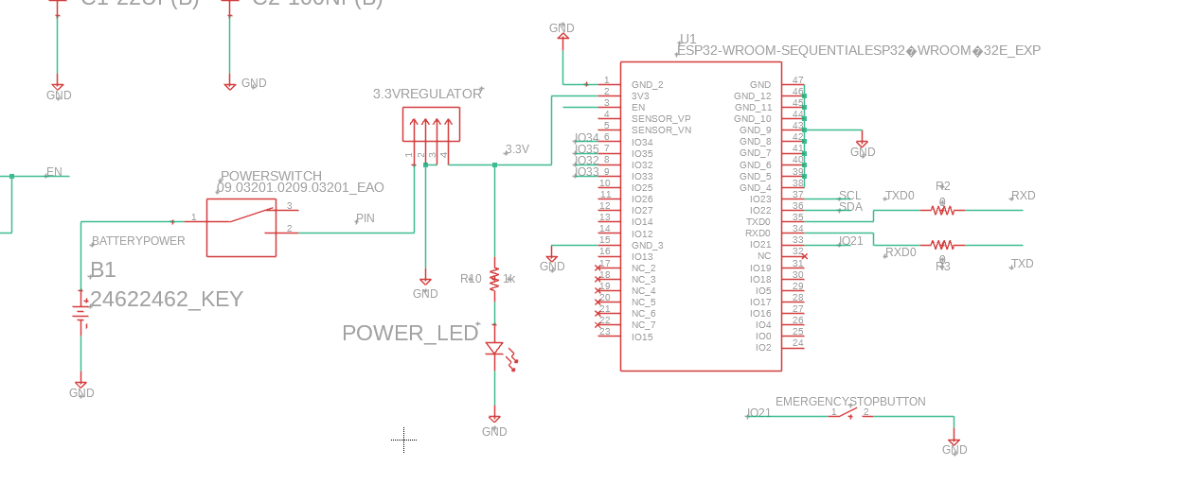
ESP32 Bluetooth Board
USB to serial converter
3.3V reg
ESP32
Joystick

Slide 37
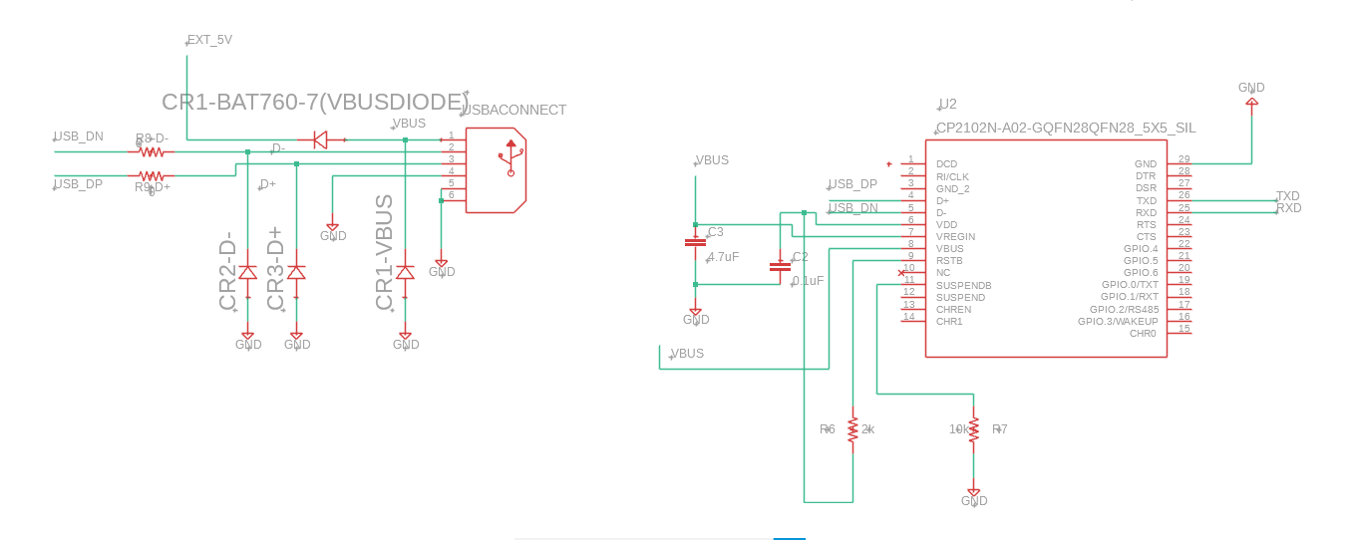
ESP32 Bluetooth Board (Continued)

Slide 38
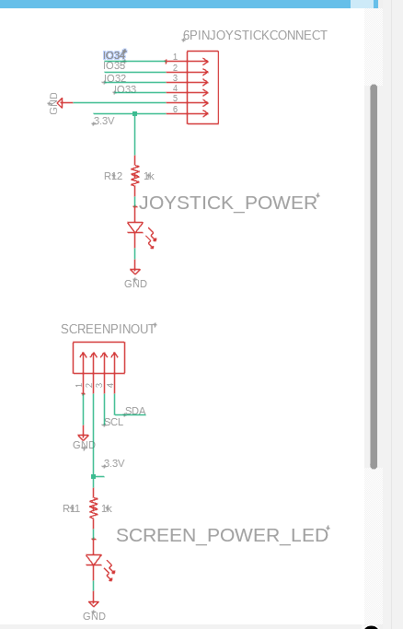
ESP32 Bluetooth Board (Continued)
Joystick has 6-pins
  4 for the ESP43 and 2 for 3.3V power and ground.
LED User Screen operated off of SDA and SCL data lines coming from programmed ESP32 chip and is powered from 3.3V reg.

Slide 39
07
PCB Layout
Implementation of electrical schematics

Slide 40
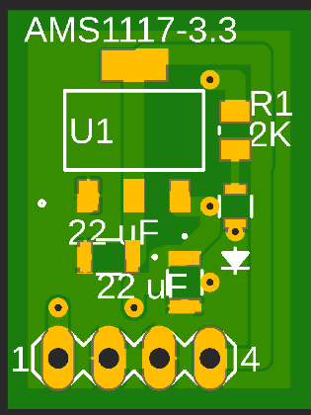
3.3 V Regulator

Slide 41
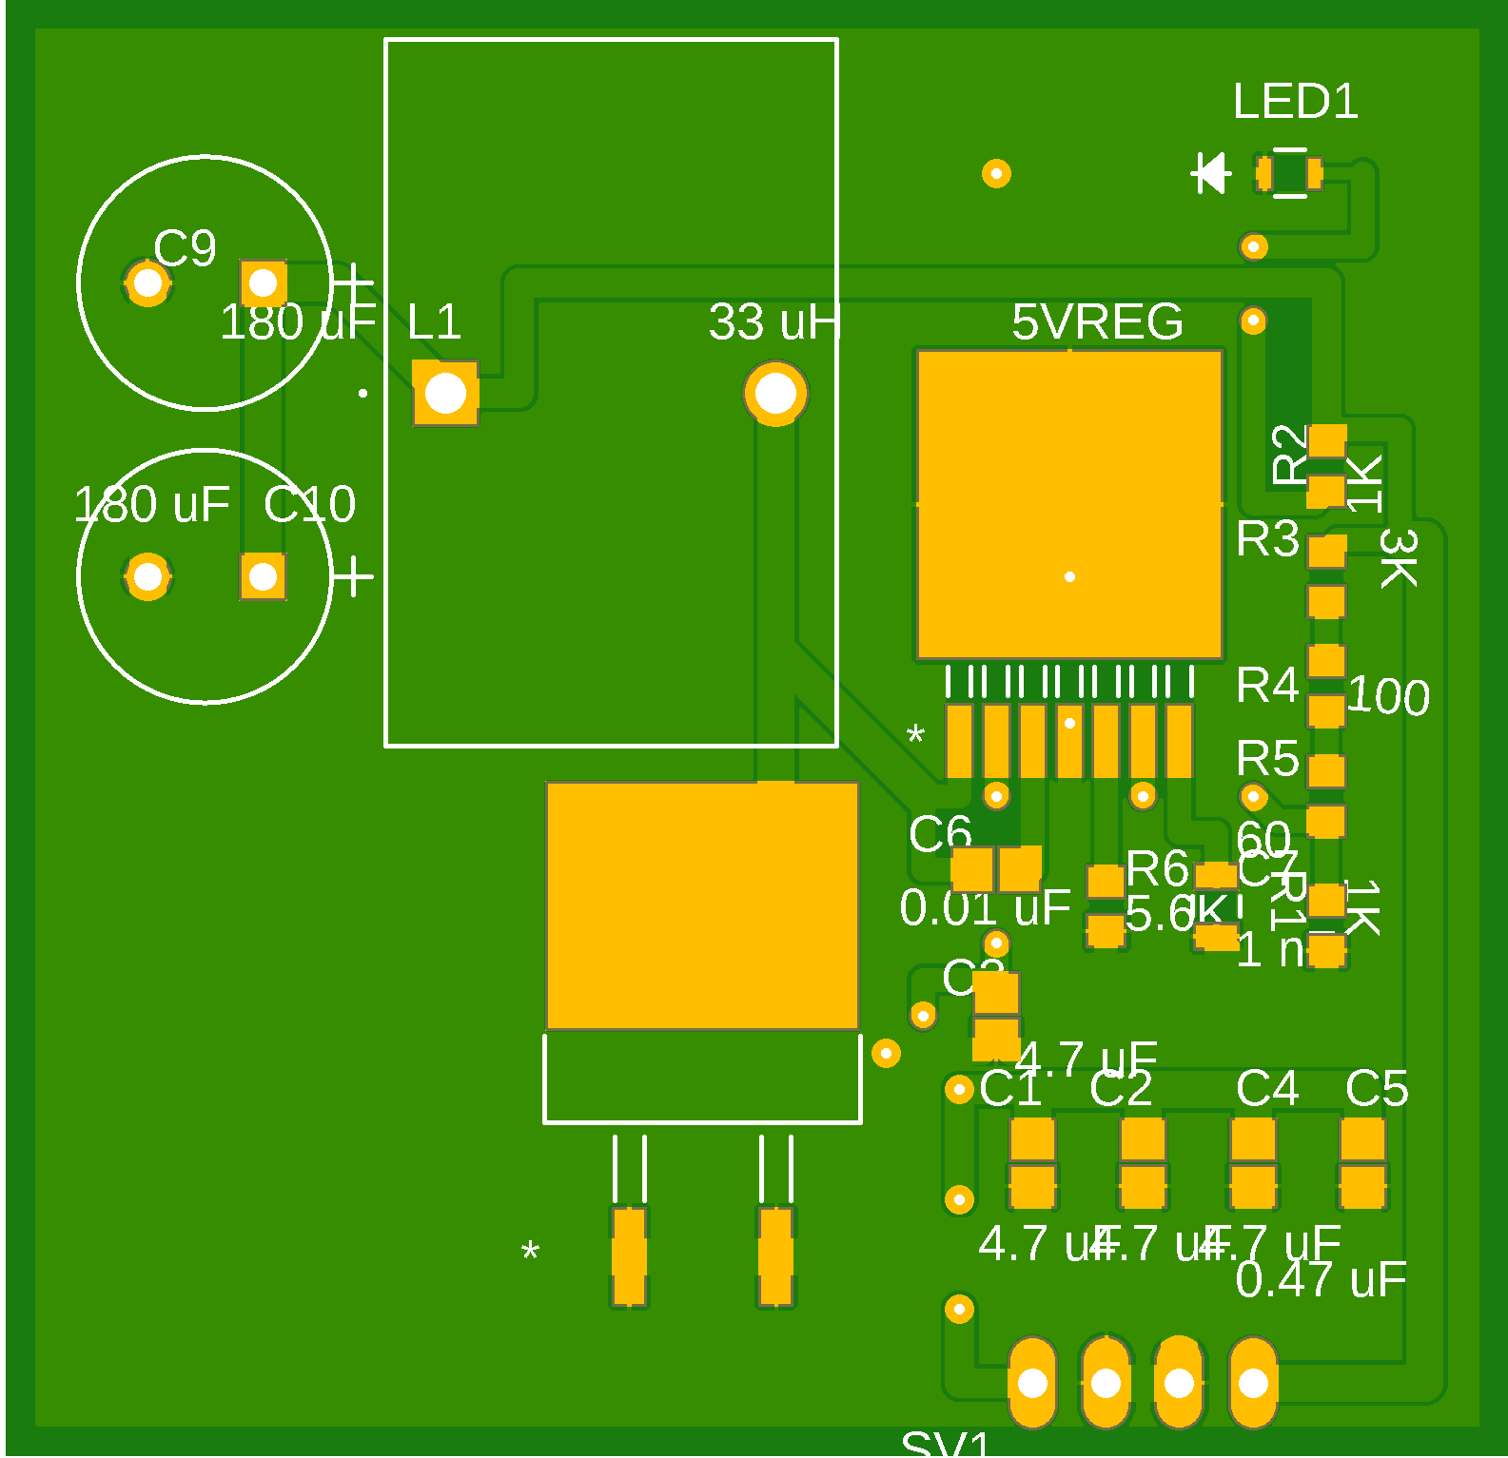
5V / 12V Regulator
Inductor
Capacitors
Regulator
Diode

Slide 42
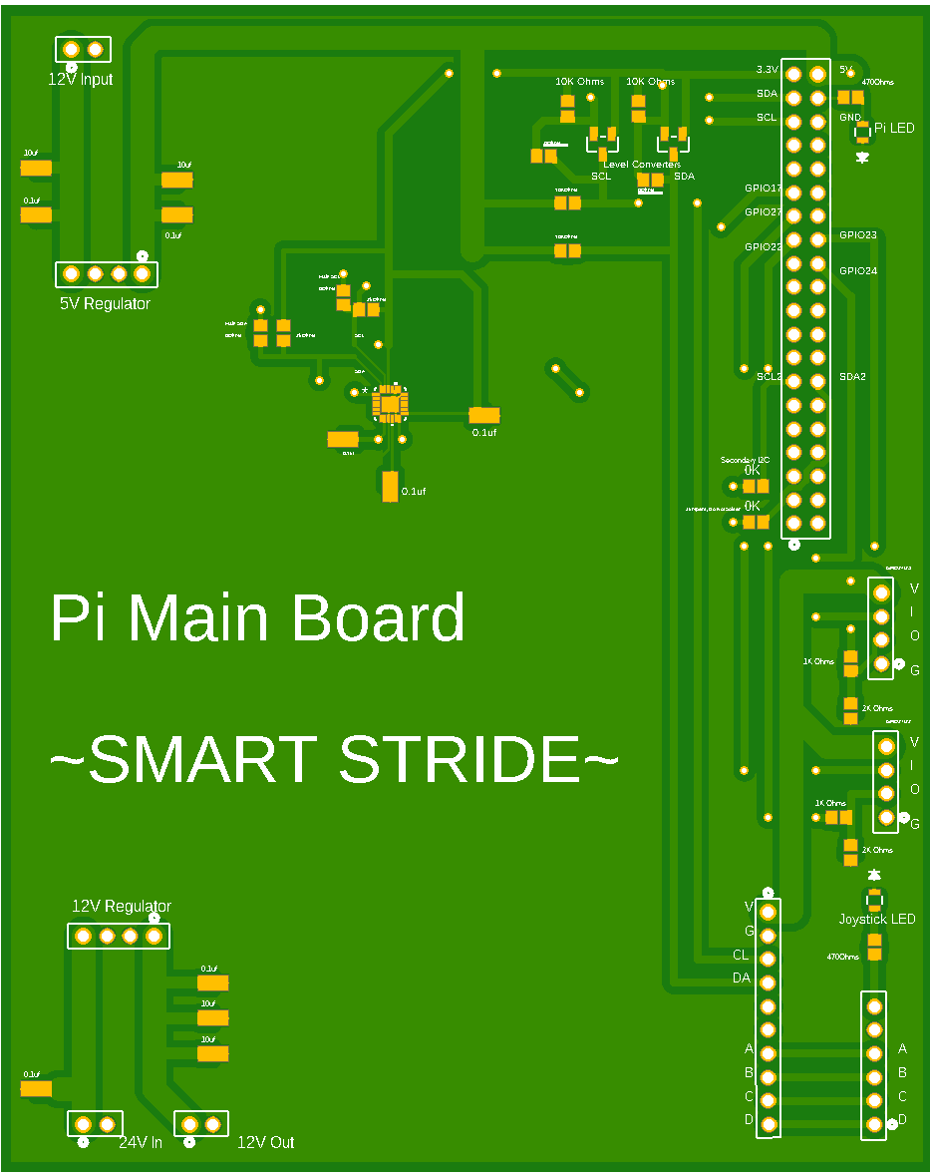
Pi to DAC Board
Pi Pin-out
5V Regulator Pinout
GPIO Headers
Level Converters
IMU Chip
12V Regulator Pinout
Chair Interface
DAC

Slide 43
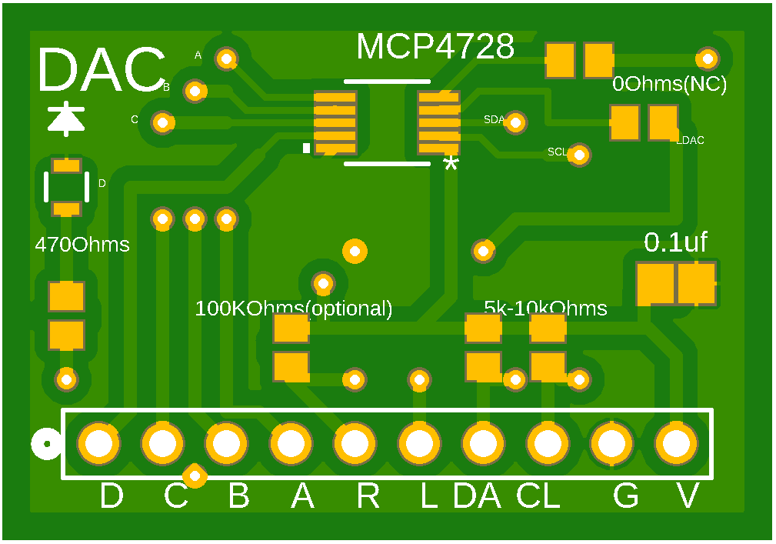
DAC
DAC Chip
Output
Input

Slide 44
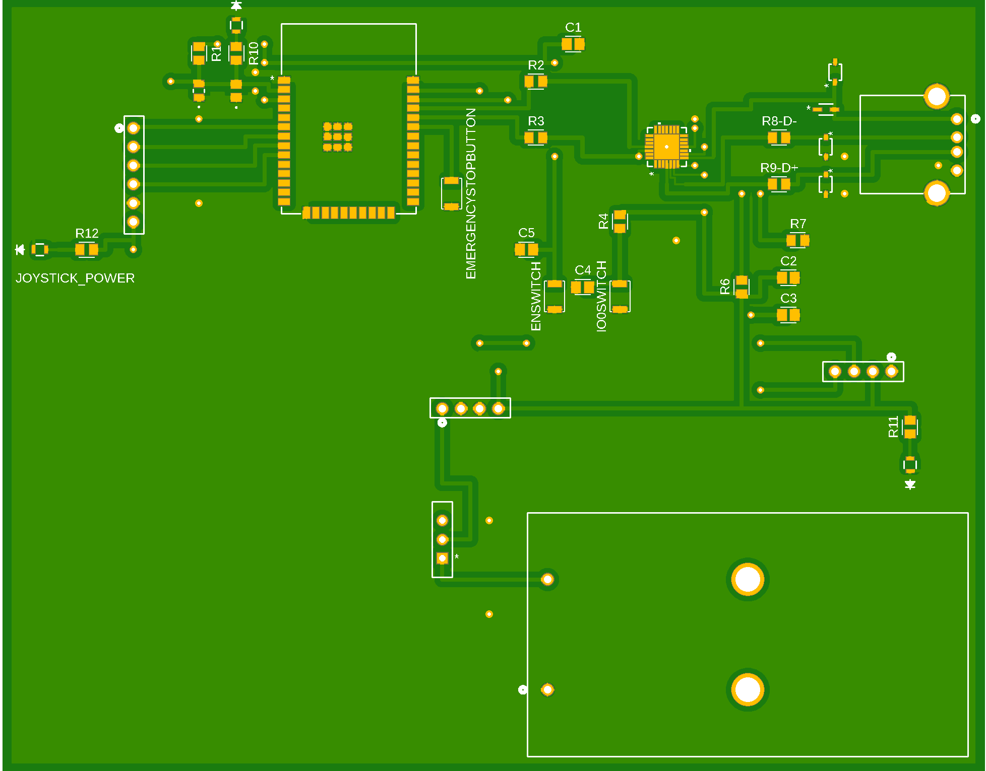
ESP32 Bluetooth Controller
UART Bridge
USB
ESP32
Joystick Pins
Screen Pins
3.3 V Input
Power Switch

Slide 45
08
Communication Protocol
Bluetooth Software Stack

Slide 46
BLE Communication Stack
ESP32 is Main Communicator of Wireless Bluetooth Signals and Messages and the Raspberry Pi 5 operates as the central client
Messages sent from ESP32 decide what mode and decisions the Raspberry Pi 5 will make
Utilizing Bluetooth Low Energy Mode to save power and enable a longer battery duration for the wireless controller.
Digitizes the analog inputs from the user joystick to send to the Pi and control the wheelchair wirelessly.
GATT Notifications enable a subscriber system meaning the Pi does not need to constantly poll for new packets and instead can receive the packet as soon as the user inputs it.
GATT Notifications reduce communication latency improving response times across all messages sent.

Slide 47
09
Software Design
Programs and digital resources used

Slide 48
Software Design and Principles
For our onboard computer designed our system with safety in mind, utilizing bluetooth notifications and making sure loops terminate in STOP conditions, we make sure our wheelchair will act cautiously in moments when we cannot rely on sensor input or connectivity
During the Pi boot up, we test connectivity to various systems and will prevent usage if any of these fail checks
We will try reconnecting every two seconds to establish connection
Using GATT notifications, we ingest commands from the controller that will be executed immediately, without polling delay
Whenever we obtain corrupted messages we stop movement
Utilizing our sensors we fuse their output to make decisions based on the mode we are in
The sensor output will be smoothed and temporal to prevent bad output
When designing the software for the ESP32 Controller safety and reliability are key needs that have to be achieved. A reliable bluetooth server setup at startup and advertisement is crucial. We also want code that doesn’t break at moments of signal loss and that safely stops the wheelchair when necessary.
On startup establish BLE server and begin advertising to establish connection
Signal drop just causes us to advertise again to establish connection as soon as possible
Emergency Stop is the prioritized task at all times to ensure safety and reliability.
ESP32 is master always transmitting so PI is always in a ready receiving state

Slide 49
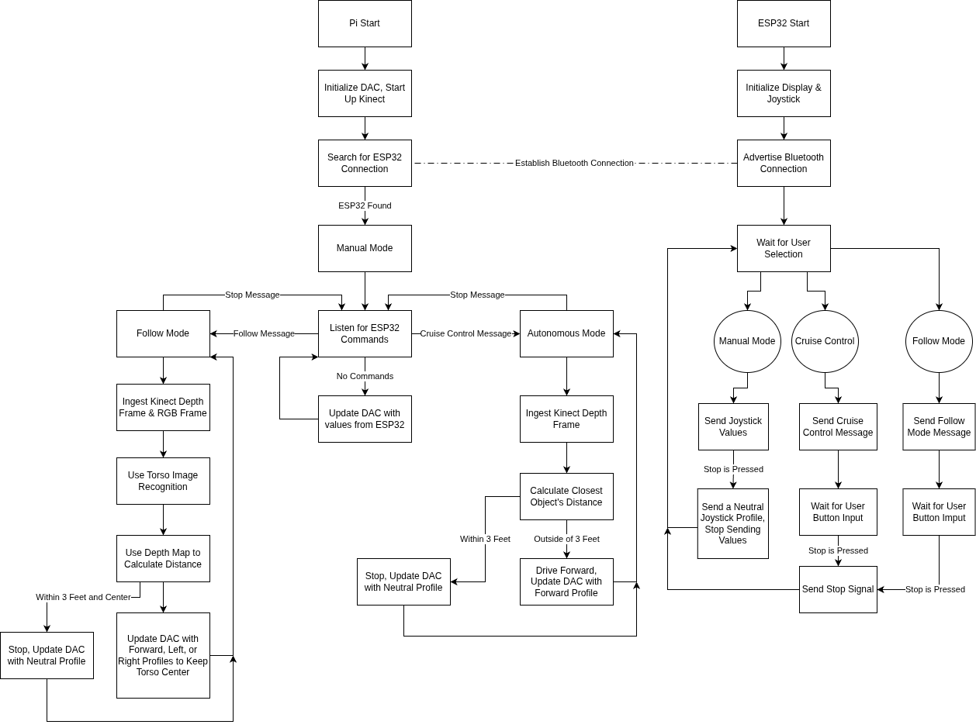
Software Flowchart

Slide 50
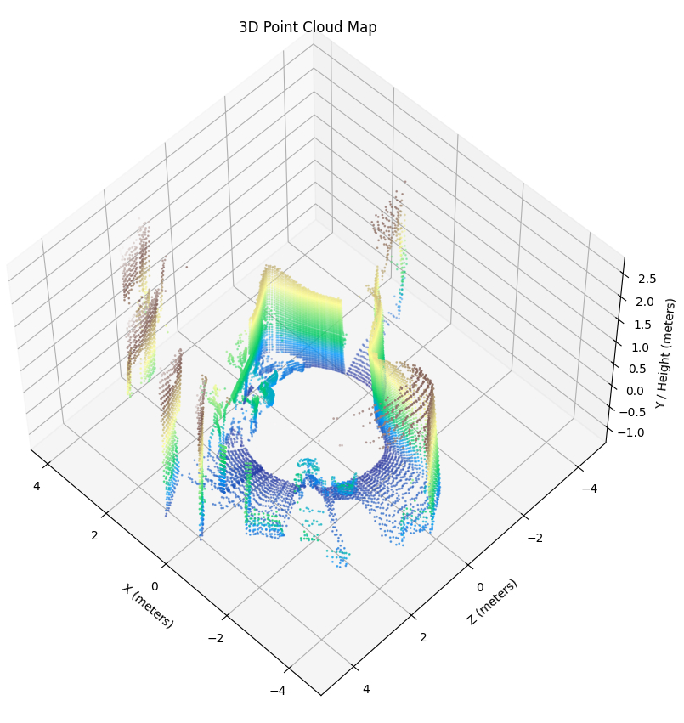
3D Mapping Results
3D mapping has yet to be implemented with a function but the chair is capable of making a 360° mapping

Slide 51
Coding Language Implementation
Category | Python | C | Java | Arduino Code
Syntax Complexity | Simple | Complex (manual memory management) | Structured but Verbose | Modern and Clean
Speed | Slower (interpreted) | Very Fast | Moderate | Moderate-Fast
Hardware Access | High-Level | Lower Hardware Level | Limited | Limited (needs libraries)
Community Support | Enormous (with Pi & Kinect) | Large (systems programming) | Large (enterprise and academia) | Large (Community and DIY development)

Slide 52
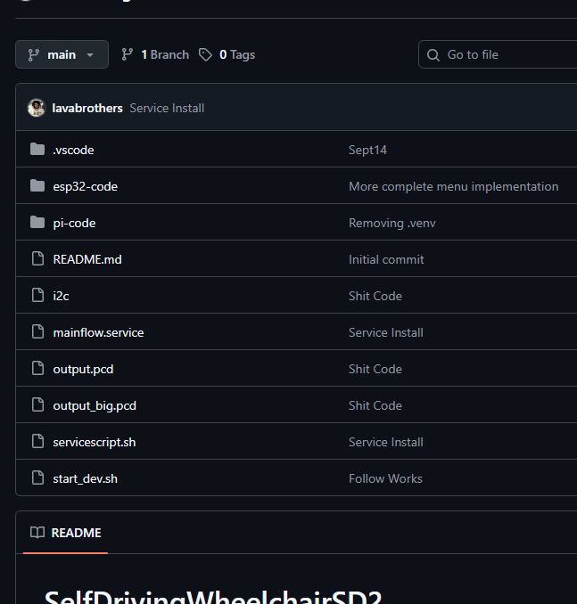
Collaborative Repository
One of our objectives is to make sure that the project could be easily replicated on wheelchairs from DIY to medical users
Github makes sharing the project’s code, including instructions on installations and previous builds, easily accessible to anyone interested in applying the project to their own chairs
Teammates are able to share their work without having to constantly send new versions for every single update
The licenses Github applies to our project allows us to protect the property to ensure that the project is as affordable as possible for other users

Slide 53
10
Prototyping and Testing
Data of the effectiveness of the project

Slide 54
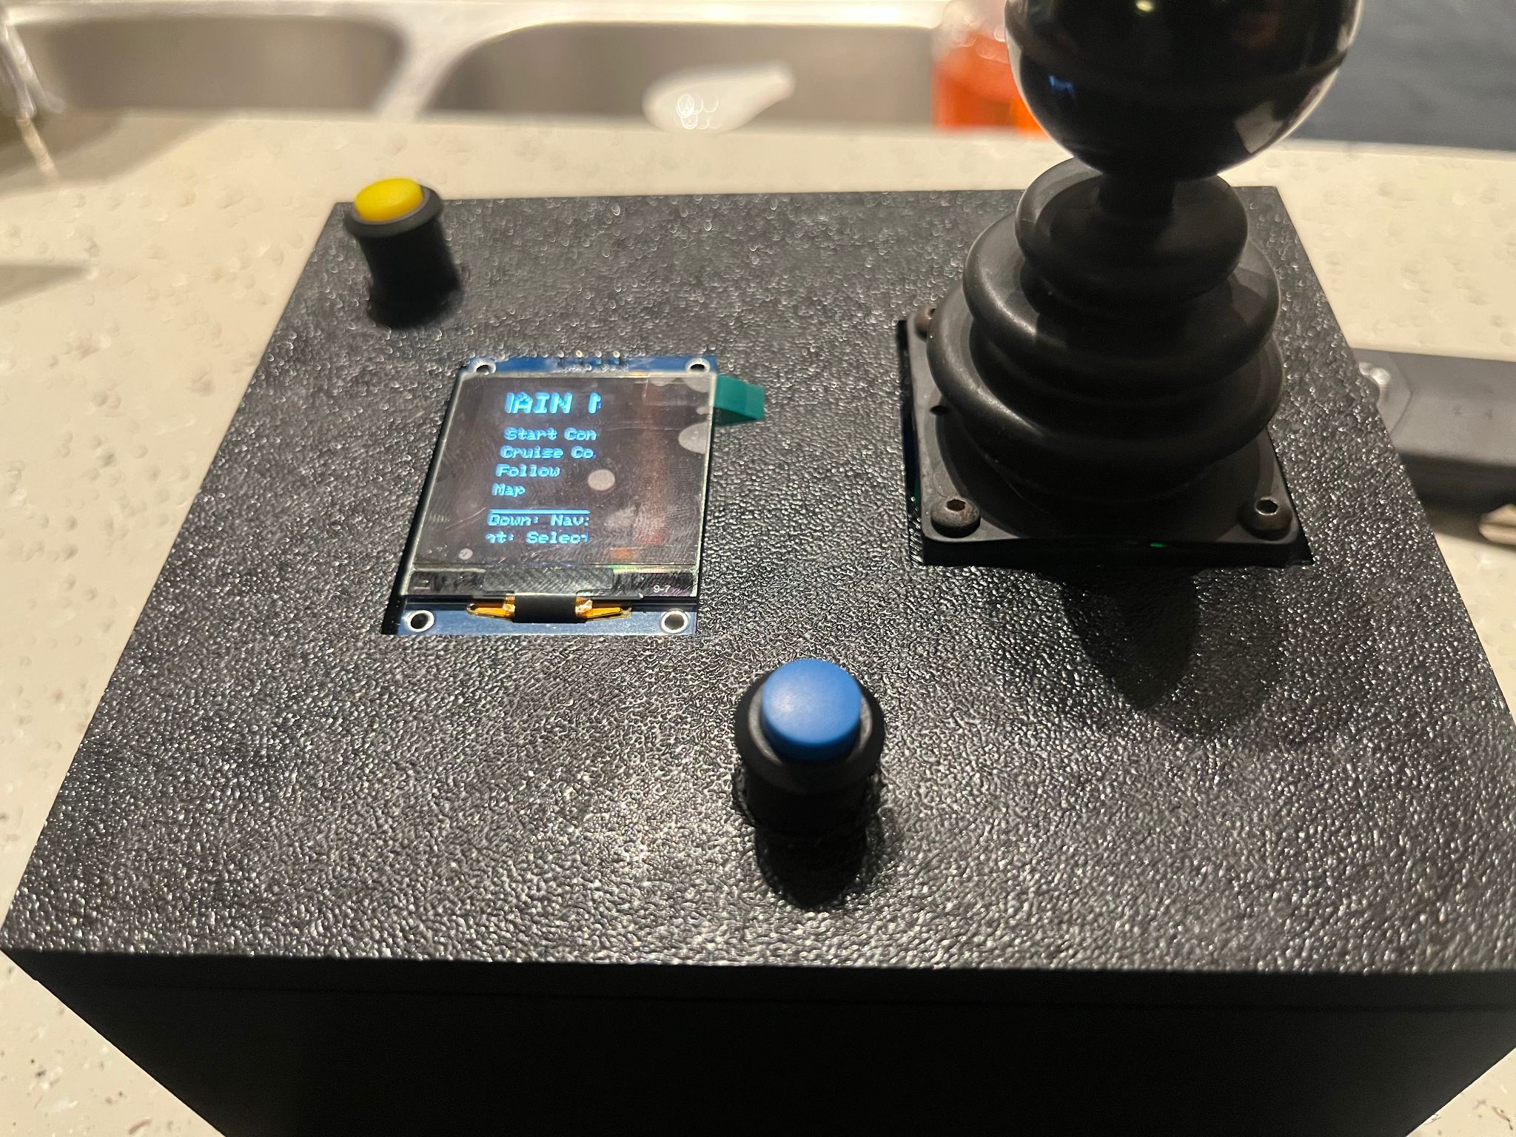
Controller Prototyping
Using the ESP32 wireless connectivity was achieved allowing users that aren’t even sitting on the chair to control it from a distance
Controller board was able to successfully communicate with Raspberry Pi from distances of up to 26 feet
ESP32 was able to use DAC to take inputs from the analog joystick and transmit them mimicking inputs as if it was a wired connection with almost 0 lag
Initial board was missing trace from one of the pins but this was fixed by wiring the connection under the board and updating the layout file

Slide 55
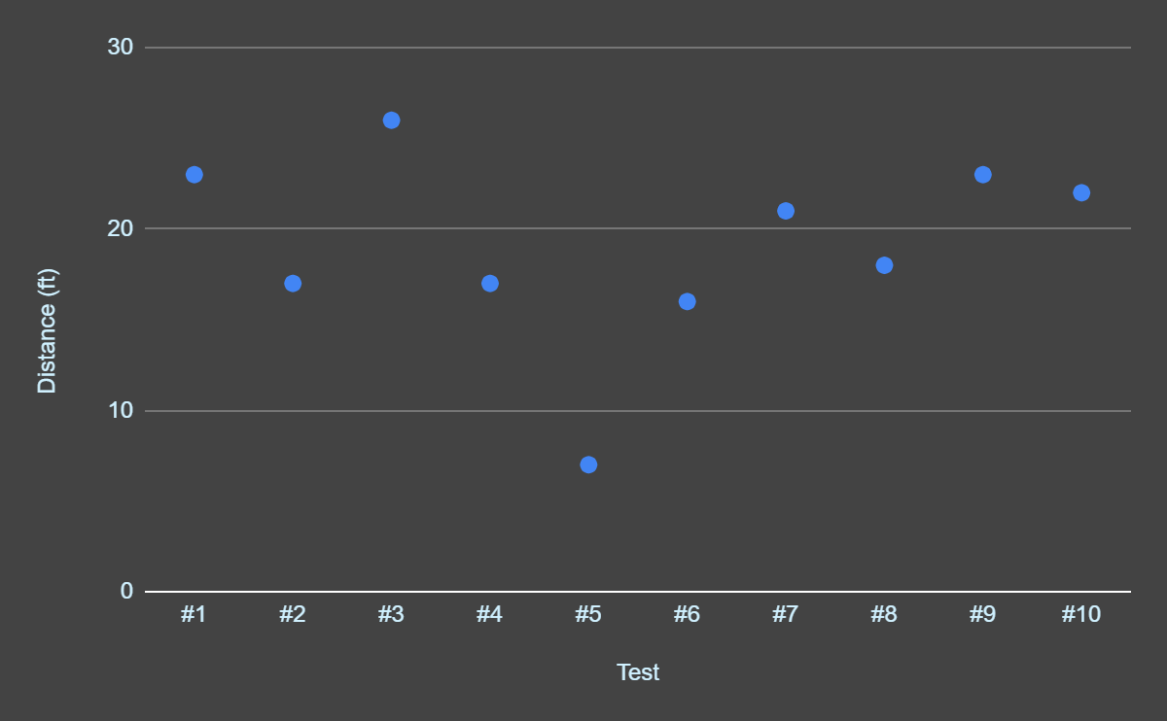
Distance Connectivity Testing
Test | Distance (ft)
#1 | 23
#2 | 17
#3 | 26
#4 | 17
#5 | 7
#6 | 16
#7 | 21
#8 | 18
#9 | 23
#10 | 22

Slide 56
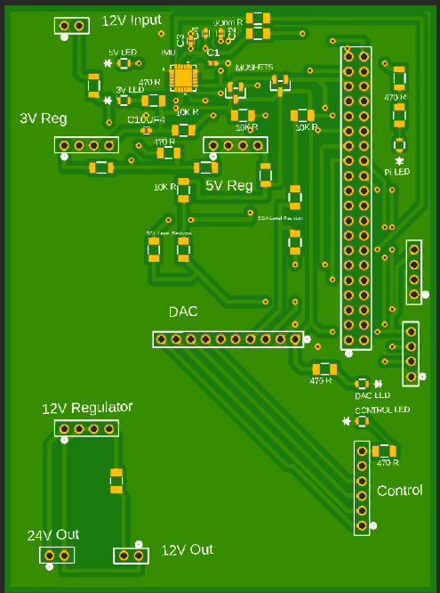
Pi to DAC Prototyping
Initially there were many problems being presented from using the Kinect with our Pi
Initial PCB design used an MPU that did not have a compass, limiting the computer from moving around efficiently
Initially, despite using the latest model, the Pi was unable to process all the images from the Kinect fast enough
In order to make up for the lack of speed the Pi has been overclocked so that it is fast enough to run the following function properly

Slide 57
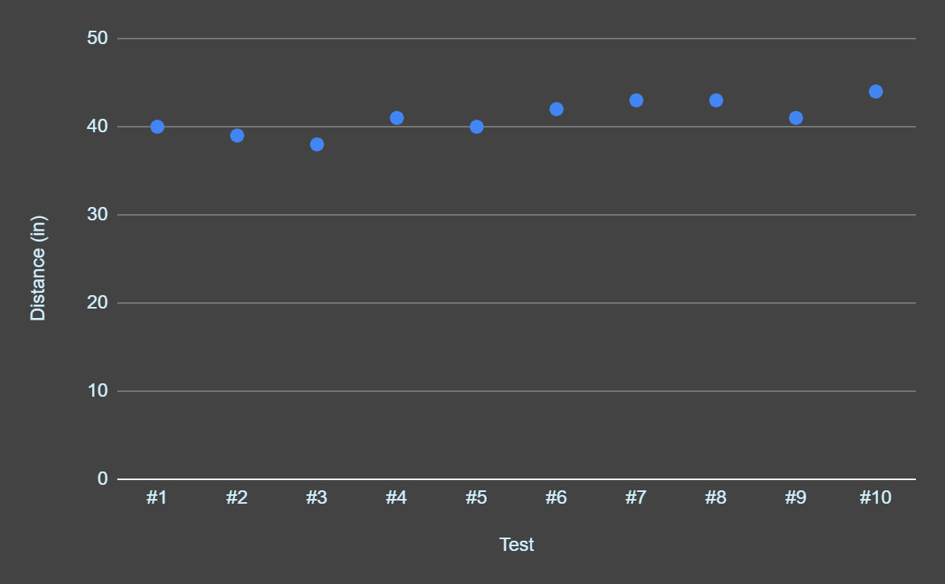
Cruise Control Stop Test
Test | Distance (in)
#1 | 40
#2 | 39
#3 | 38
#4 | 41
#5 | 40
#6 | 42
#7 | 43
#8 | 43
#9 | 41
#10 | 44

Slide 58
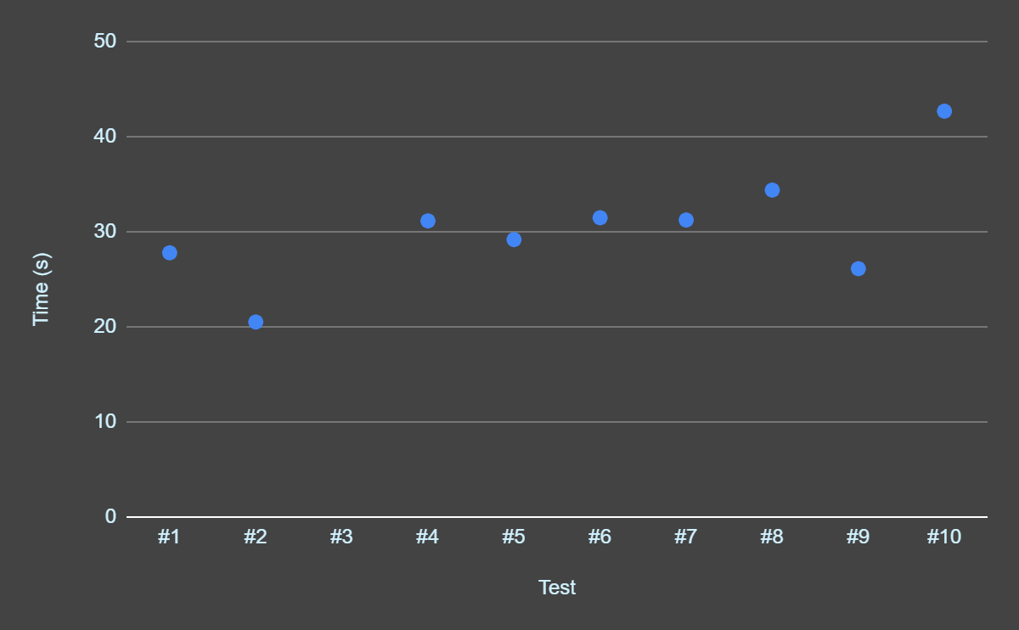
Follow Function Test
Test | Time (s)
#1 | 27.79
#2 | 20.51
#3 | Failure
#4 | 31.15
#5 | 29.18
#6 | 31.48
#7 | 31.24
#8 | 34.39
#9 | 26.12
#10 | 42.69

Slide 59
Miscellaneous Information Collected
Besides the test data collected from running experiments and testing overall functionality there were some functions that could be improved and some errors that occured
While it doesn’t happen often, sometimes the controller will disconnect randomly, this can be addressed by installing an external antennae with future designs to increase signal strength
The follow function does work just as well as intended however it is not capable of stopping in the event of an object getting in the way between the person it is tracking and the chair
While the IR sensor is effective if the room or area the chair is in has a lot of IR sensors those sensors can get confuse the SmartStride and get a series of values that can cause the chair to freeze as it can not determine the distance between objects

Slide 60
11
Administrative Content
The background behind our design philosophy

Slide 61
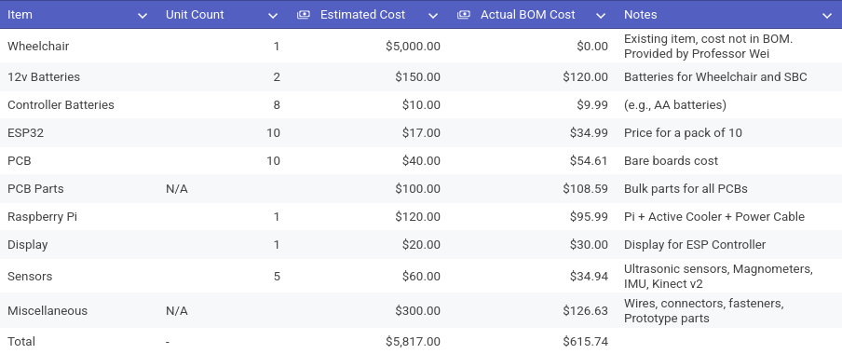
Original Estimated Bill of Materials

Slide 62
Actual Bill of Materials
Item | Estimated Cost | Actual Cost
Wheelchair | $0 | $0
PCBs | $54 | $134.34
DAC & MPU | $95 | $95
Components | $138.63 | $247.45
Kinect | $30 | $30
12V Batteries | $120 | $123.67
Pi | $95.55 | $95.55
Total | $533.18 | $726.01

Slide 63
Distribution of Labor
Adam Lilly
Regulator Design
Wheelchair Hardware Retrofitting
PCB Testing and Verification
Matthew Itskovich
ESP32 PCB Design and Programming
Bluetooth Communication Programming
Software Debugging
Evan Rees
Wheelchair Control and Self Driving Programming
Pi Hat PCB Design
Pi to Wheelchair Communication Debugging and Prototyping
Coordinates, leads meetings, and ensures meeting milestones
Arturo Lara
3D CAD/ Modelling
PCB Manufacturing
Administrative Documentation

Slide 64
SmartStride: The Wireless Controller
Using the SmartStride Wireless Controller, users only need to remove the stock joystick that came with their char
Features included:
On/Off button for the controller itself
Emergency stop button for the chair
LCD screen with menu displaying the current status of the chairs
Functions that can be chosen through the controller
  Manual Drive
  Automatic Cruise Control
  Follow Command
Manual Drive will also display the input on an X and Y axis

Slide 65
Thanks
Do you have any questions?
youremail@freepik.com
+34 654 321 432
yourwebsite.com

